Slide 1
A numerical tool for design and explicit chemical interpretation of low salinity water flooding experiments
K. Kurgyis¹, B. Flemisch², R. Helmig², J. Hommel², H. Ott¹
Presenter: Kata Kurgyis
¹ Montanuniversität Leoben, Austria
² University of Stuttgart, Germany

Slide 2



Low Salinity Water Flooding
Ca²⁺
Mg²⁺
SO₄²⁻
IOR and EOR
H₂O
Why Low Salinity Waterflood?
Cheap materials
Simple technology
Environmental friendly

Slide 3
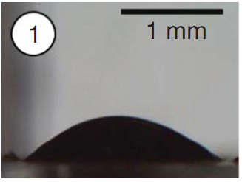
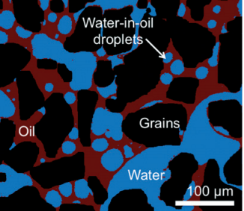
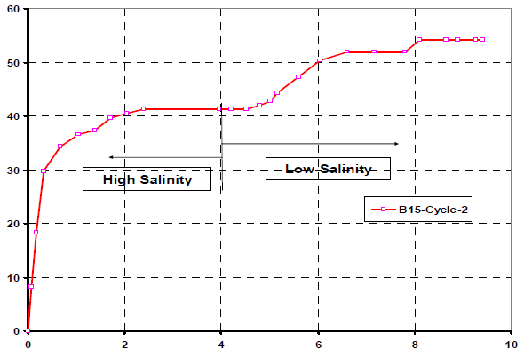
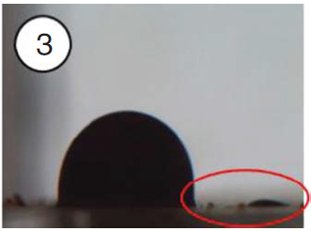
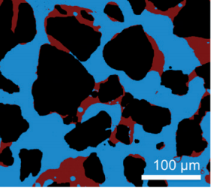
LSWF Governing mechanisms
Mahani et al. (2015)
Song & Kovscek (2015)
Seccombe et al. (2010)
a
HS
Oil recovery
b
LS
Modified capillary properties
Injected PV
Change in injection water composition
Oil desorption from mineral surface
Oil redistribution, mobilization
Additional oil recovery
Improved oil mobility
Notes:
Alkaline like behavior: decreased IFT, increased pH, surfactant generation, emulsification

Slide 4

LSWF Governing mechanisms
Seccombe et al. (2010)
Oil recovery
Double layer expansion
Multi-component ion exchange
Osmosis
Fine migration
Alkaline like behavior
Modified capillary properties
Injected PV
Change in injection water composition
Oil desorption from mineral surface
Oil redistribution, mobilization
Additional oil recovery
Improved oil mobility
Notes:
Alkaline like behavior: decreased IFT, increased pH, surfactant generation, emulsification

Slide 5
Implementation: Kuznetsov-models
Increasing complexity
Salinity
Adsorption
Reactions
Base Case
Conventional waterflood
Model 1
Dissolved tracer
Model 2
Adsorbed tracer
Model 3
Mechanistic model
Two-phase immiscible displacement
Salinity dependent fluid-matrix interaction
Adsorption dependent fluid-matrix interaction
Adsorption controlled by DLE and MIE
BRINE
OIL
BRINE
OIL
BRINE
OIL
SOLID
BRINE
OIL
SOLID
High Sal
Low Sal
High Sal
Low Sal
High Sal
Low Sal
DLE
MIE

Slide 6
Salinity
Adsorption
Reactions
Base Case
Conventional waterflood
Model 1
Dissolved tracer
Model 2
Adsorbed tracer
Model 3
Mechanistic model
Two-phase immiscible displacement
Salinity dependent fluid-matrix interaction
Adsorption dependent fluid-matrix interaction
Adsorption controlled by DLE and MIE
BRINE
OIL
BRINE
OIL
BRINE
OIL
SOLID
BRINE
OIL
SOLID
High Sal
Low Sal
High Sal
Low Sal
High Sal
Low Sal
DLE
MIE

Slide 7
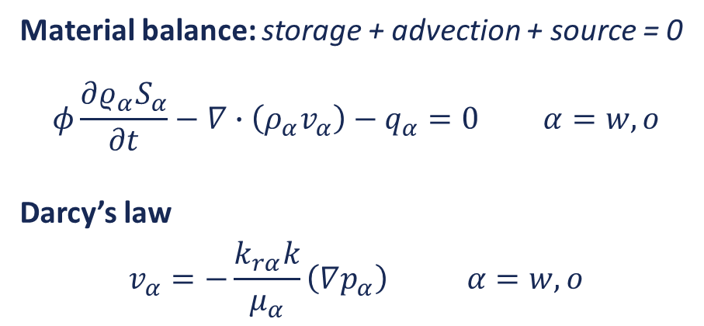
Conceptual model of core flooding
USS setup
Q_{LS} = c
X_{w,s} = LS
S_{w,ini} = S_{wr}
p_{ini} = p_{B}
X_{w,s} = HS
p_{B} = c
Water injection
Fluid production
2-phase immiscible displacement
Point of interest:
Pressure change
Saturation change
Material balance: storage + advection + source = 0
$$φ\frac{∂ρ_{α}S_{α}}{∂t}−∇∙\left(ρ_{α}v_{α}\right)−q_{α}=0 α=w,o$$
Darcy’s law
$$v_{α}=−\frac{k_{rα}k}{μ_{α}}\left(∇p_{α}\right) α=w,o$$
p_{c}

Slide 8
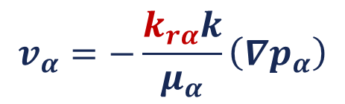

Mechanistic model – saturation functions
$$v_{α}=−\frac{k_{rα}k}{μ_{α}}\left(∇p_{α}\right)$$
INTERPOLATED RELATIVE PERMEABILITY
$$k_{rα}^{t}=F k_{rα}^{LS}+\left(1−F\right) k_{rα}^{HS}$$

Slide 9
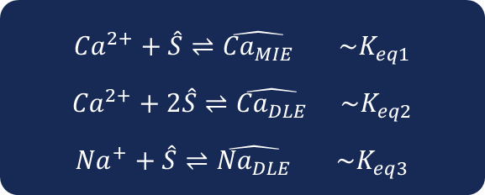
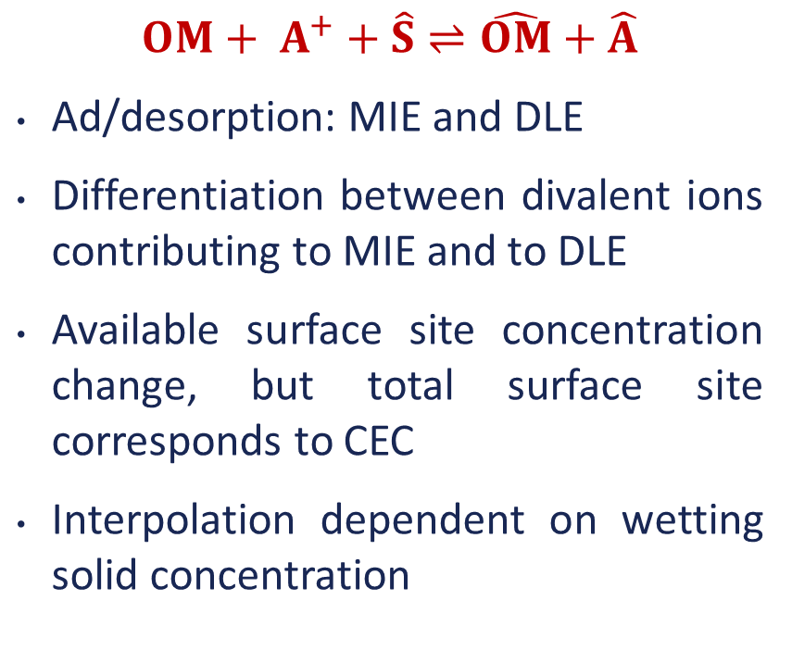


Mechanistic model – reaction sets
$$OM+ A^{+}+\hat{S}⇌\hat{OM}+\hat{A}$$
Ad/desorption: MIE and DLE
Differentiation between divalent ions contributing to MIE and to DLE
Available surface site concentration change, but total surface site corresponds to CEC
Interpolation dependent on wetting solid concentration
$${Ca}^{2+}+\hat{S}⇌\hat{{Ca}_{MIE}} \sim K_{eq1}$$
$${Ca}^{2+}+2\hat{S}⇌\hat{{Ca}_{DLE}} \sim K_{eq2}$$
$${Na}^{+}+\hat{S}⇌\hat{{Na}_{DLE}} \sim K_{eq3}$$
$${\hat{S}}_{tot}=\hat{S}+\hat{{Ca}_{MIE}}+2 \hat{{Ca}_{DLE}}+\hat{{Na}_{DLE}}$$
$$c_{ws}=\hat{{Ca}_{MIE}}+2 \hat{{Ca}_{DLE}}+\hat{{Na}_{DLE}}$$

Slide 10
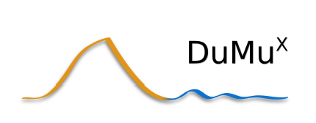
Numerical versus analytical solution - SF

Slide 11
Numerical versus analytical solution - SF

Slide 12
Numerical versus analytical solution - TF

Slide 13
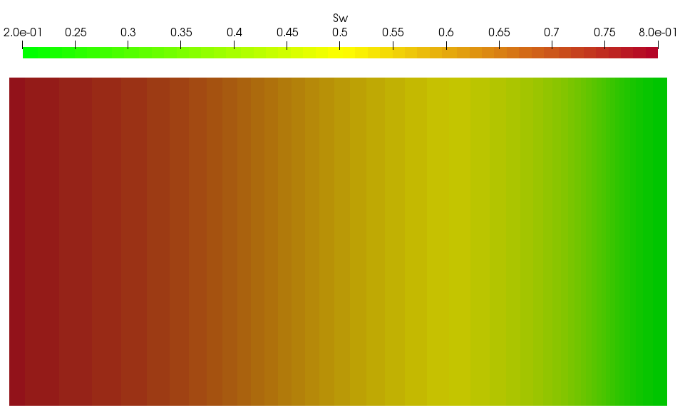
Low Salinity Waterflood in the Lab
Experiment
Simulation
Conventional SCAL: ∆p and V_{prod}
Effluent analysis: x_{w}^{H2O}, x_{w}^{Salt}
Computer tomography: S_{w}

Slide 14
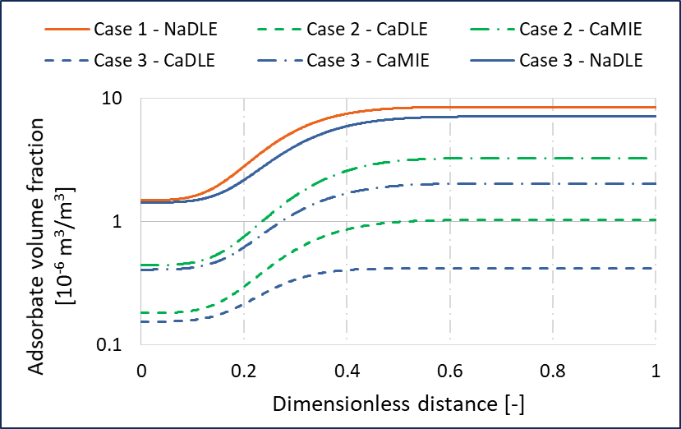
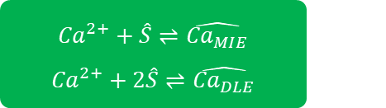

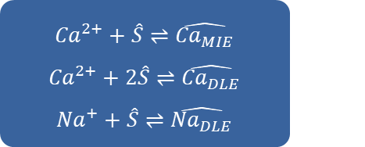
Explicit chemistry: relative contribution of ions
Increasing complexity
Case 1: only NaCl
Case 2: only CaCl₂
Case 3: NaCl and CaCl₂
$${Na}^{+}+\hat{S}⇌\hat{{Na}_{DLE}}$$
$${Ca}^{2+}+\hat{S}⇌\hat{{Ca}_{MIE}}$$
$${Ca}^{2+}+2\hat{S}⇌\hat{{Ca}_{DLE}}$$
$${Ca}^{2+}+\hat{S}⇌\hat{{Ca}_{MIE}}$$
$${Ca}^{2+}+2\hat{S}⇌\hat{{Ca}_{DLE}}$$
$${Na}^{+}+\hat{S}⇌\hat{{Na}_{DLE}}$$

Slide 15

Thank you for your attention!
Kata Kurgyis
E-mail: kata.kurgyis@unileoben.ac.at
Affiliation: Chair of Reservoir Engineering
Department of Petroleum Engineering
Montanuniversität Leoben, Austria
Webpage: www.dpe.ac.at

